Slide 1

Research Topic
Learner Name
Student Id
Course & Batch
Assessor:
Supervisor:

Slide 2
Table of Contents
Introduction.
Aim of research.
Research question & Hypothesis. - IV,DV
Objective of research.
Literature Review.
Scope of research.
Top level architecture & WBS.
Methodology.
Limitations of research.
Timeline.
Cost & Benefit.
Conclusion.
Acknowledgement.
Table of Contents

Slide 3

Introduction.

Slide 4
Introduction
The introduction in a research proposal serves as the opening section that lays the foundation for your research. It sets the context and provides the background needed to understand the significance and rationale of the study. The introduction typically includes several key components to engage the reader and establish the importance of the research

Slide 5
2. Aim of Research.

Slide 6
Aim
The aim of the research is a broad statement that defines the overall purpose or goal of your study. It outlines what you intend to achieve through your research and provides direction for the entire study. The research aim is typically more general than specific research objectives, and it is usually formulated in a way that encapsulates the core focus of the research
Example: The aim of the research is to assess the effectiveness of CNN in detecting and classifying Covid – 19 infection in lung images, also comparing the performance of CNNs with traditional methods commonly used for Covid – 19 detection.

Slide 7
3. Research Question

Slide 8
Research Question
Research Question:
Dependent Variables:
Independent Variable
Example: Can a Convolutional Neural Network effectively detect and classify Covid -19 infection using the images of X-rays of lungs.
How does the performance of CNN compare to traditional methods like PCR, Antigen, Serological tests.

Slide 9
4. Objective of Research

Slide 10
Objective & Sub objectives
Objectives break down the aim into manageable parts and guide the methodology and analysis
Example:
To evaluate the effectiveness of CNN in the detection & classification of covid-19 infection using chest x-ray images.
To evaluate the sensitivity and specificity of CNN in detecting covid-19 infection using chest x-ray images comparing the accuracy of CNN based classification with traditional methods.

Slide 11
Objective
To analyze the performance of diverse datasets to investigate the robustness of Convolutional Neural Network.
To compare the accuracy of my trained model with already trained model, create a better model along with its algorithm with minimum accuracy of 90%.

Slide 12
5. Scope of Research

Slide 13
Scope
The scope defines the boundaries and extent of the research or project. It outlines what will be covered in terms of objectives, target audience, time frame, methodologies, and resources.
To provide a clear understanding of what the project or study aims to achieve, the areas it will focus on, and the boundaries within which the work will operate

Slide 14
6.Limitations of Research

Slide 15
Limitations
Limitations refer to the potential constraints or weaknesses in the study or project that may affect its outcomes or conclusions. These could be due to factors such as resources, methodology, time, data quality, or uncontrollable external factors.
To acknowledge and inform readers or stakeholders about factors that might limit the accuracy, applicability, or generalizability of the findings

Slide 16
7. Methodology

Slide 17
Methodology
Research design:- A Qualitative/ Quantitative/ Mixed method approach chosen for comprehensive insights.
Data collection method:- Experiment, Survey, Interviews/focus group, Observation, Ethnography, Archival research, Secondary data collection
Literature sources: Journals (Refereed, Non-refereed academic, Professional, Magazines), Books and e-books, Newspapers, Conference proceedings, Reports, Theses.

Slide 18
Literature Review

Slide 19
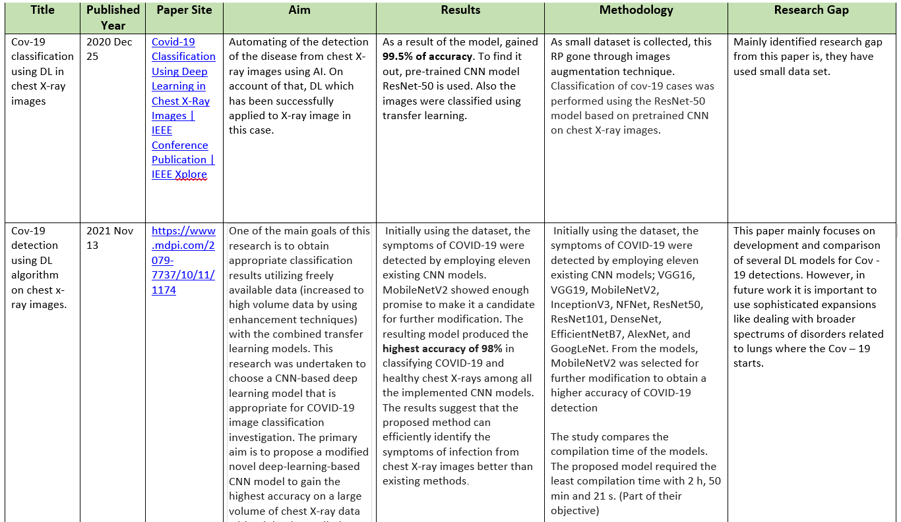

Slide 20
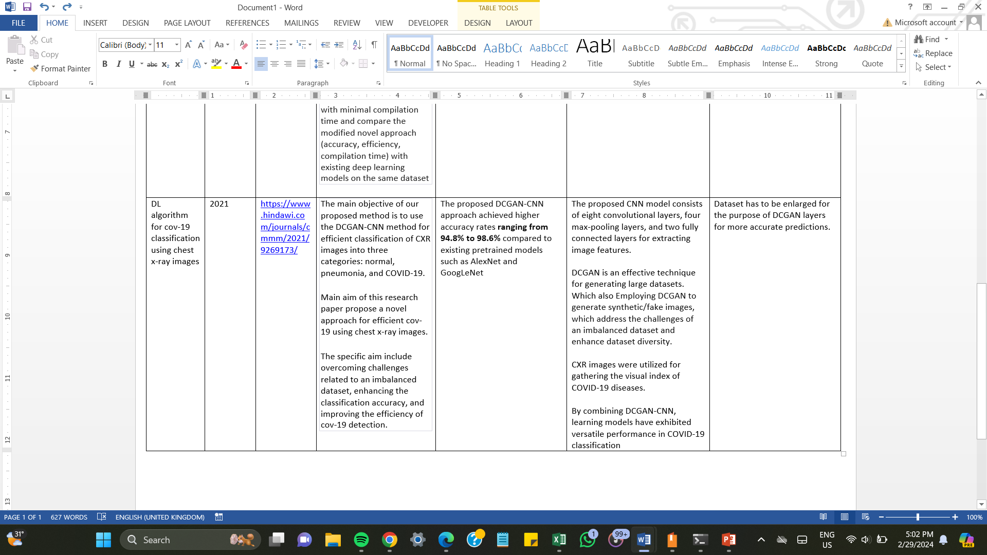

Slide 21
Timeline

Slide 22
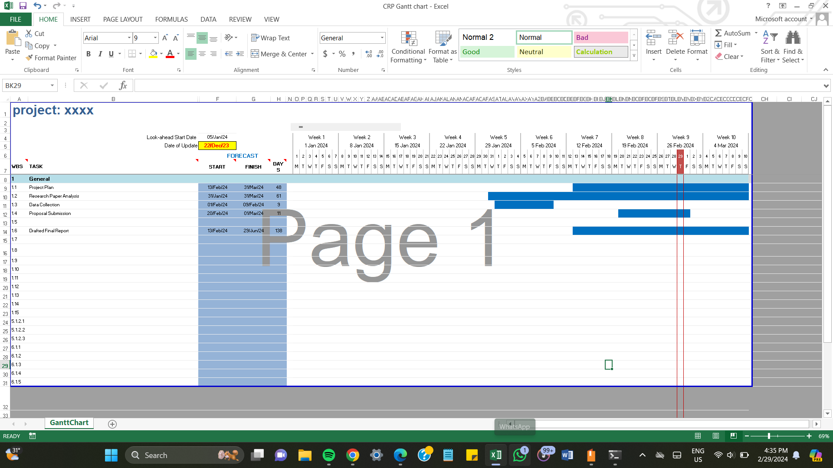

Slide 23
Cost & Benefits

Slide 24
Cost
Radiographers | 9 GBP
Data Collection | 14GBP
Computational Resources | 42GBP
InfraStructure | 34GBP
Man power | 1 hour = 1GBP
Total man power per day | 6 hours = 6GBP
Total Cost | 105 GBP
Invested amount = 142GBP
Cost = 105GBP
Actual profit = 37GBP
1 GBP approximately = 350 Lkr
Benefits
Time
Deployed Model

Slide 25
Top level architecture & WBS

Slide 26
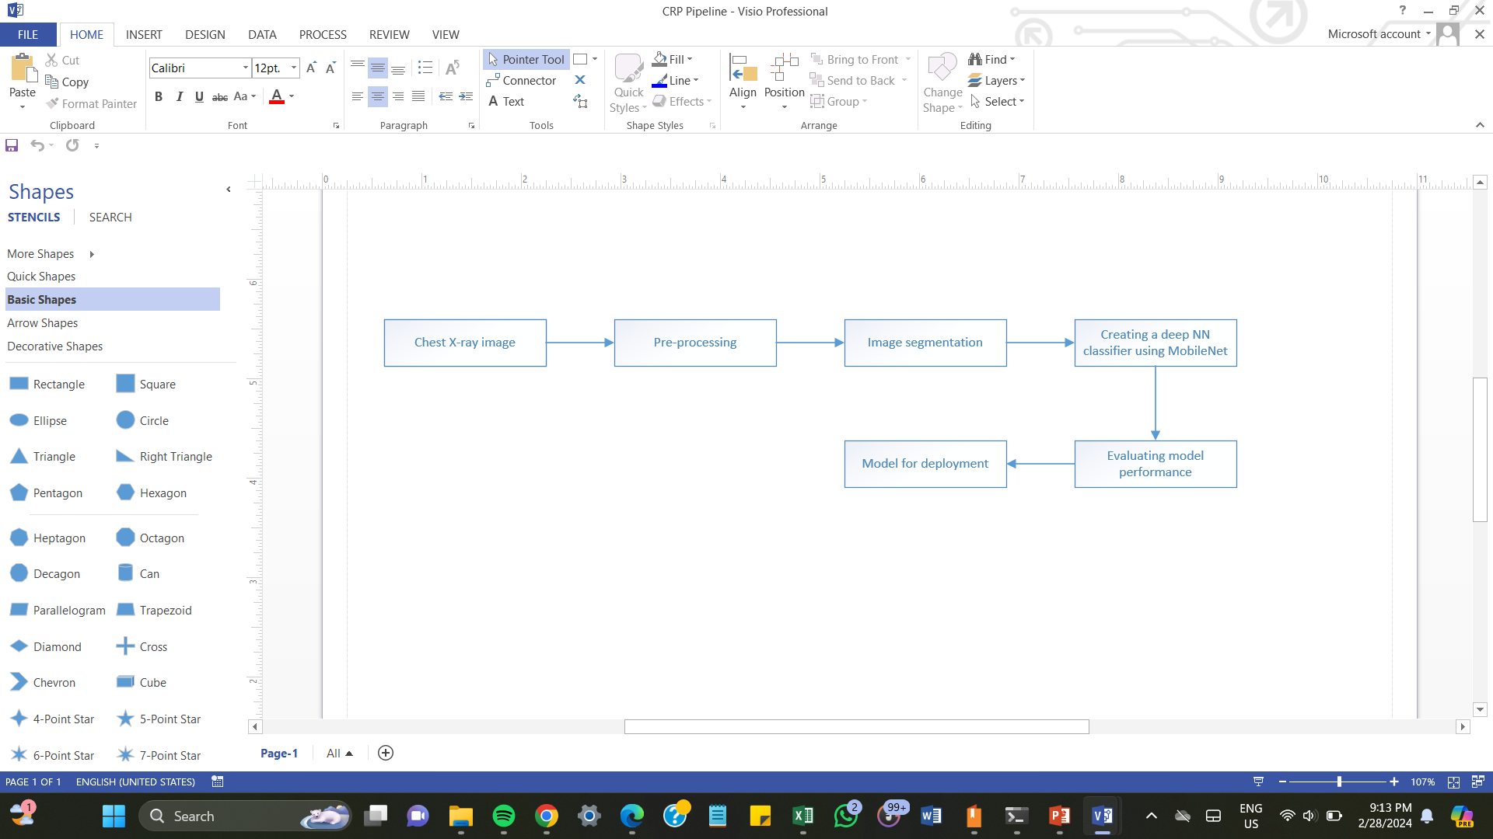
Pipeline

Slide 27
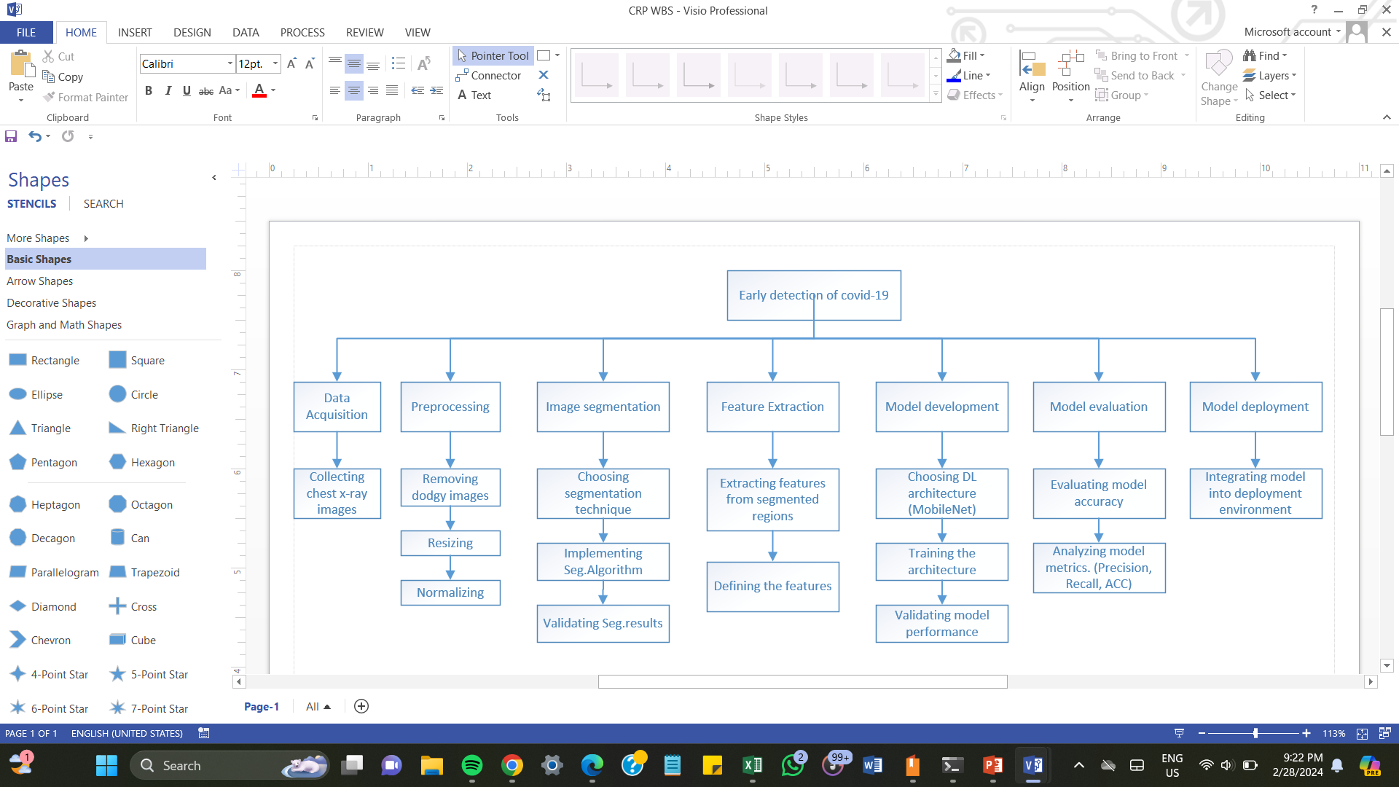
Work Break Down Structure

Slide 28
Conclusion

Slide 29
Conclusion
My research examines the effectiveness of CNN model by comparing its performance with the performance of traditional methods which are used to detect covid-19. By bridging existing literature gaps through a robust methodology, this study aims to improve my research by taking multi-class and enough amount of images around 12000. Despite its limitations, this research findings promise to significantly fulfill all the objectives & ultimately, I’ll be recommending some recommendations on how this research can be enriched in future.

Slide 30

Acknowledgement

Slide 31

Questions?

Slide 32

Thank you

